Slide 1


Slide 2
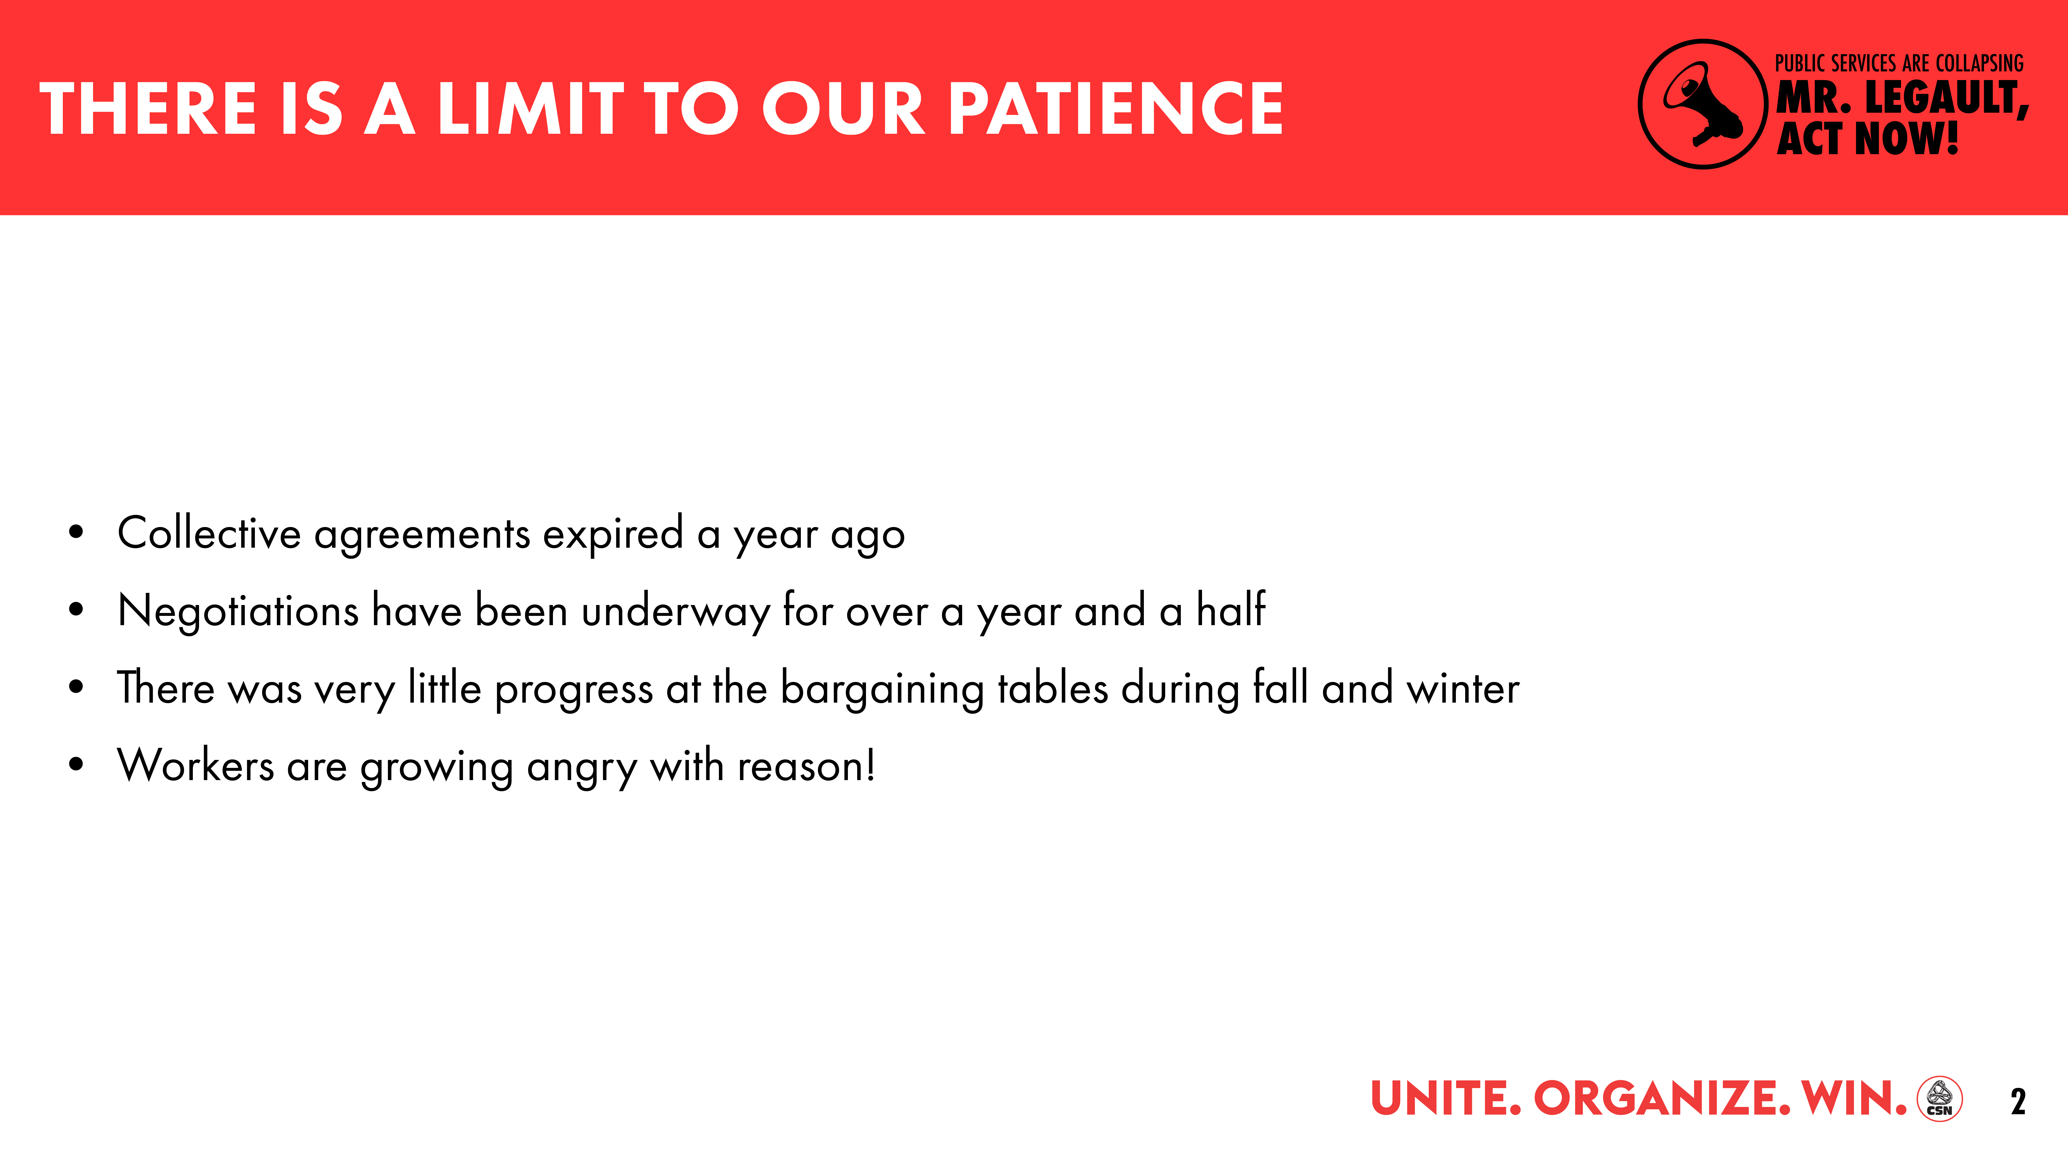

Slide 3
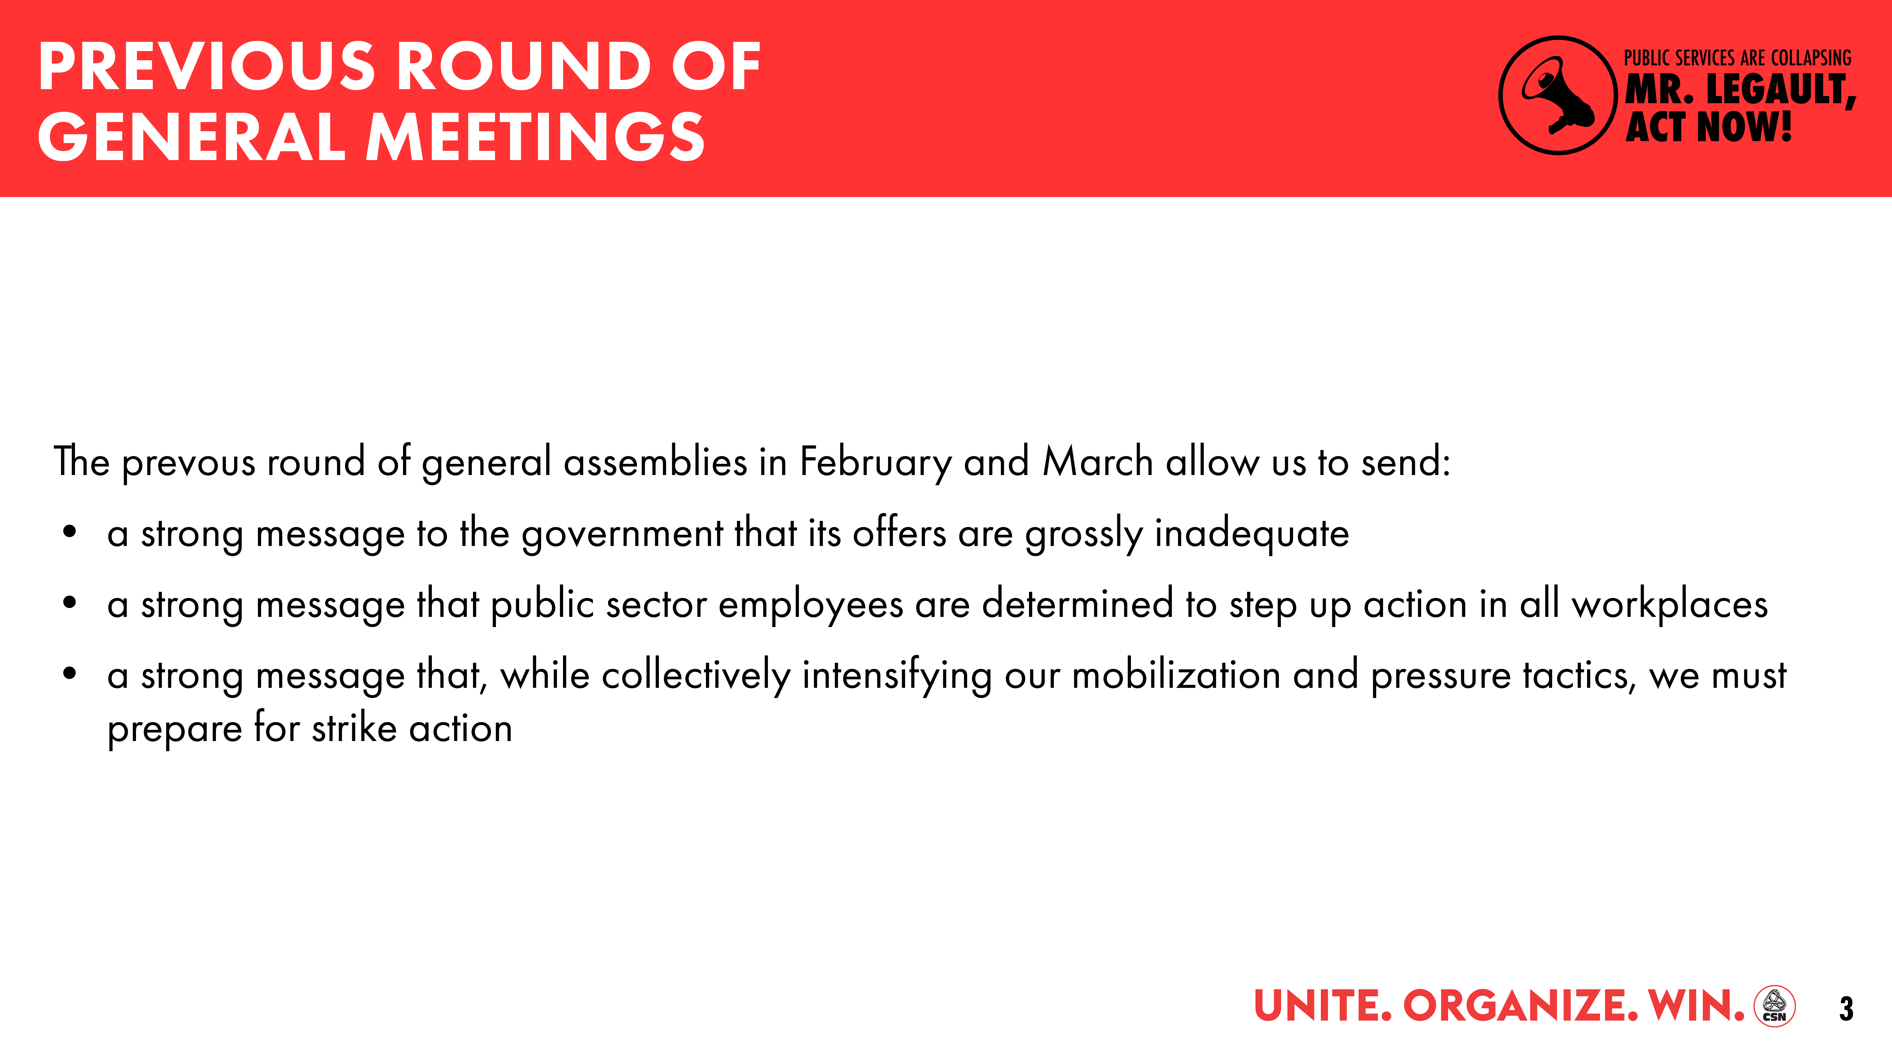

Slide 4
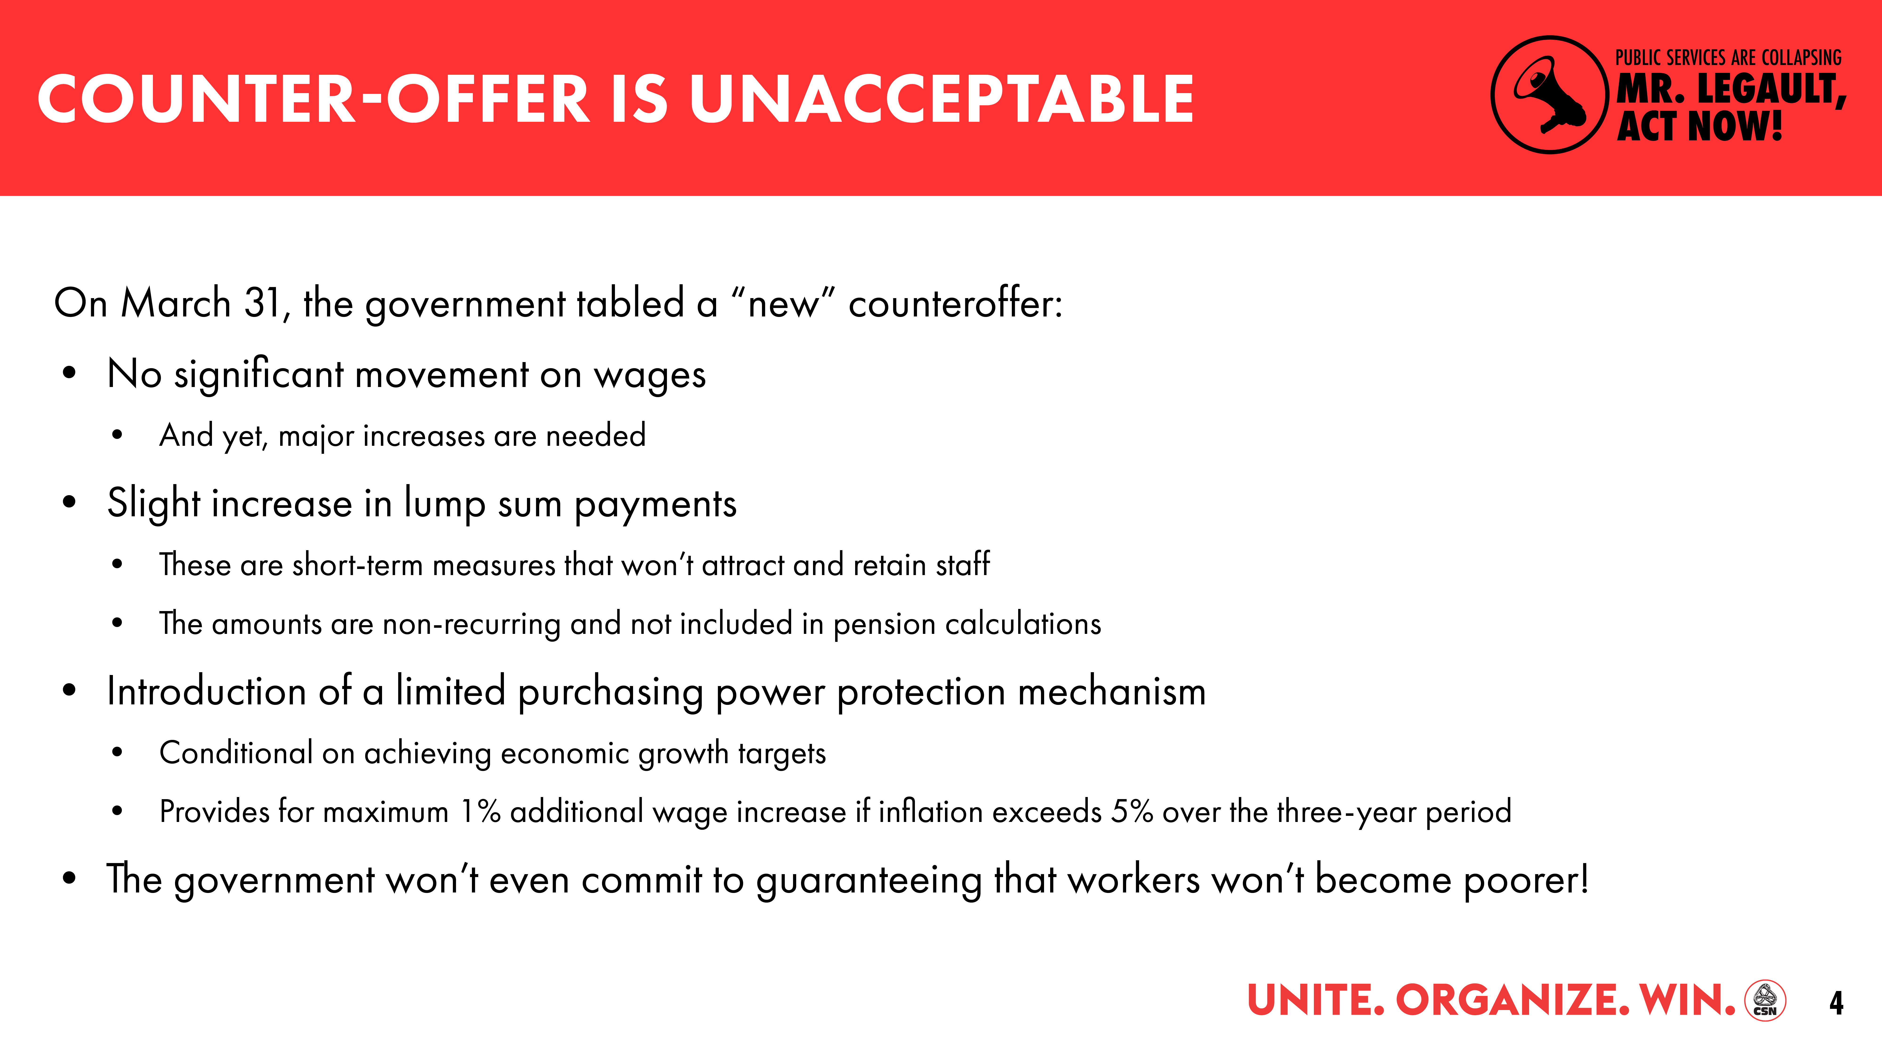

Slide 5
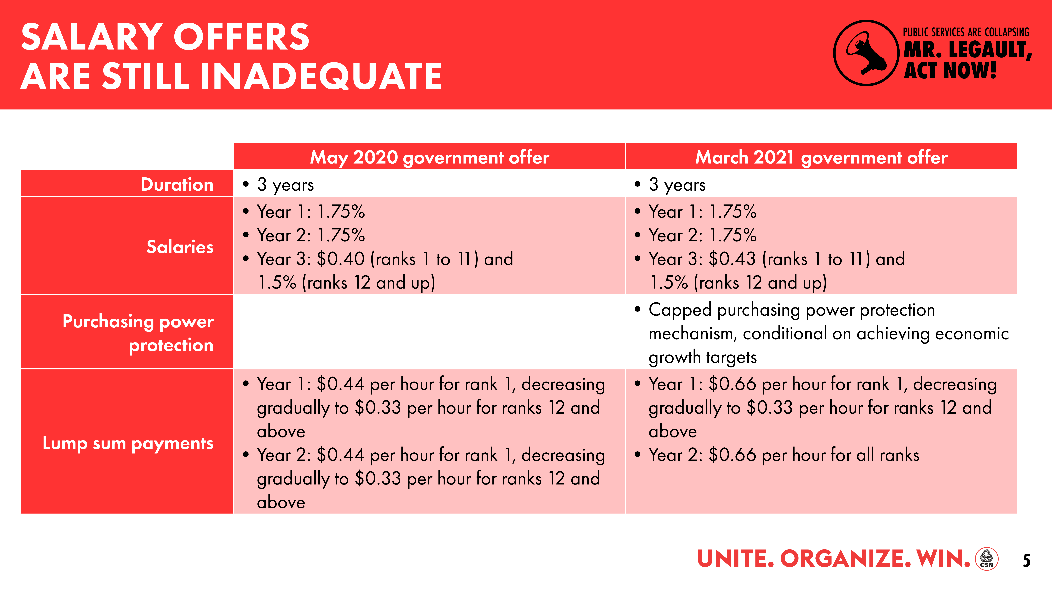

Slide 6
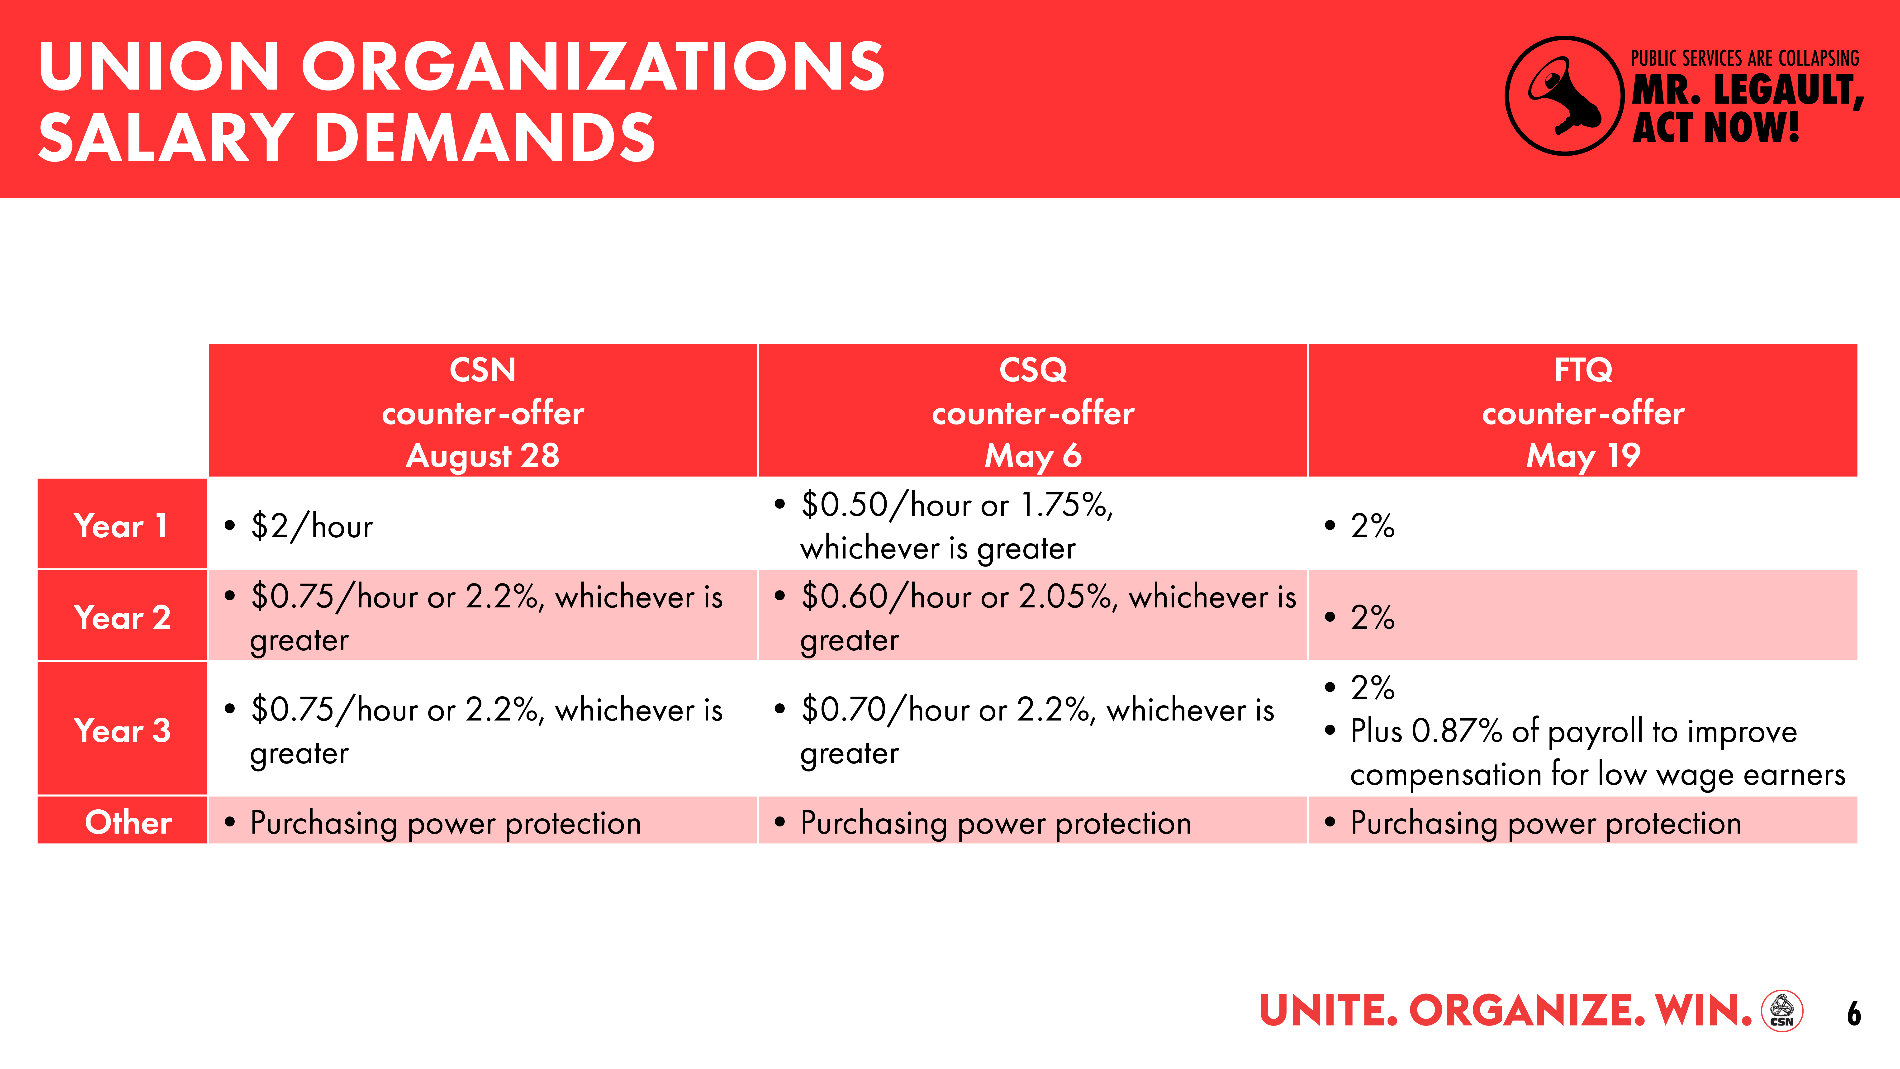

Slide 7
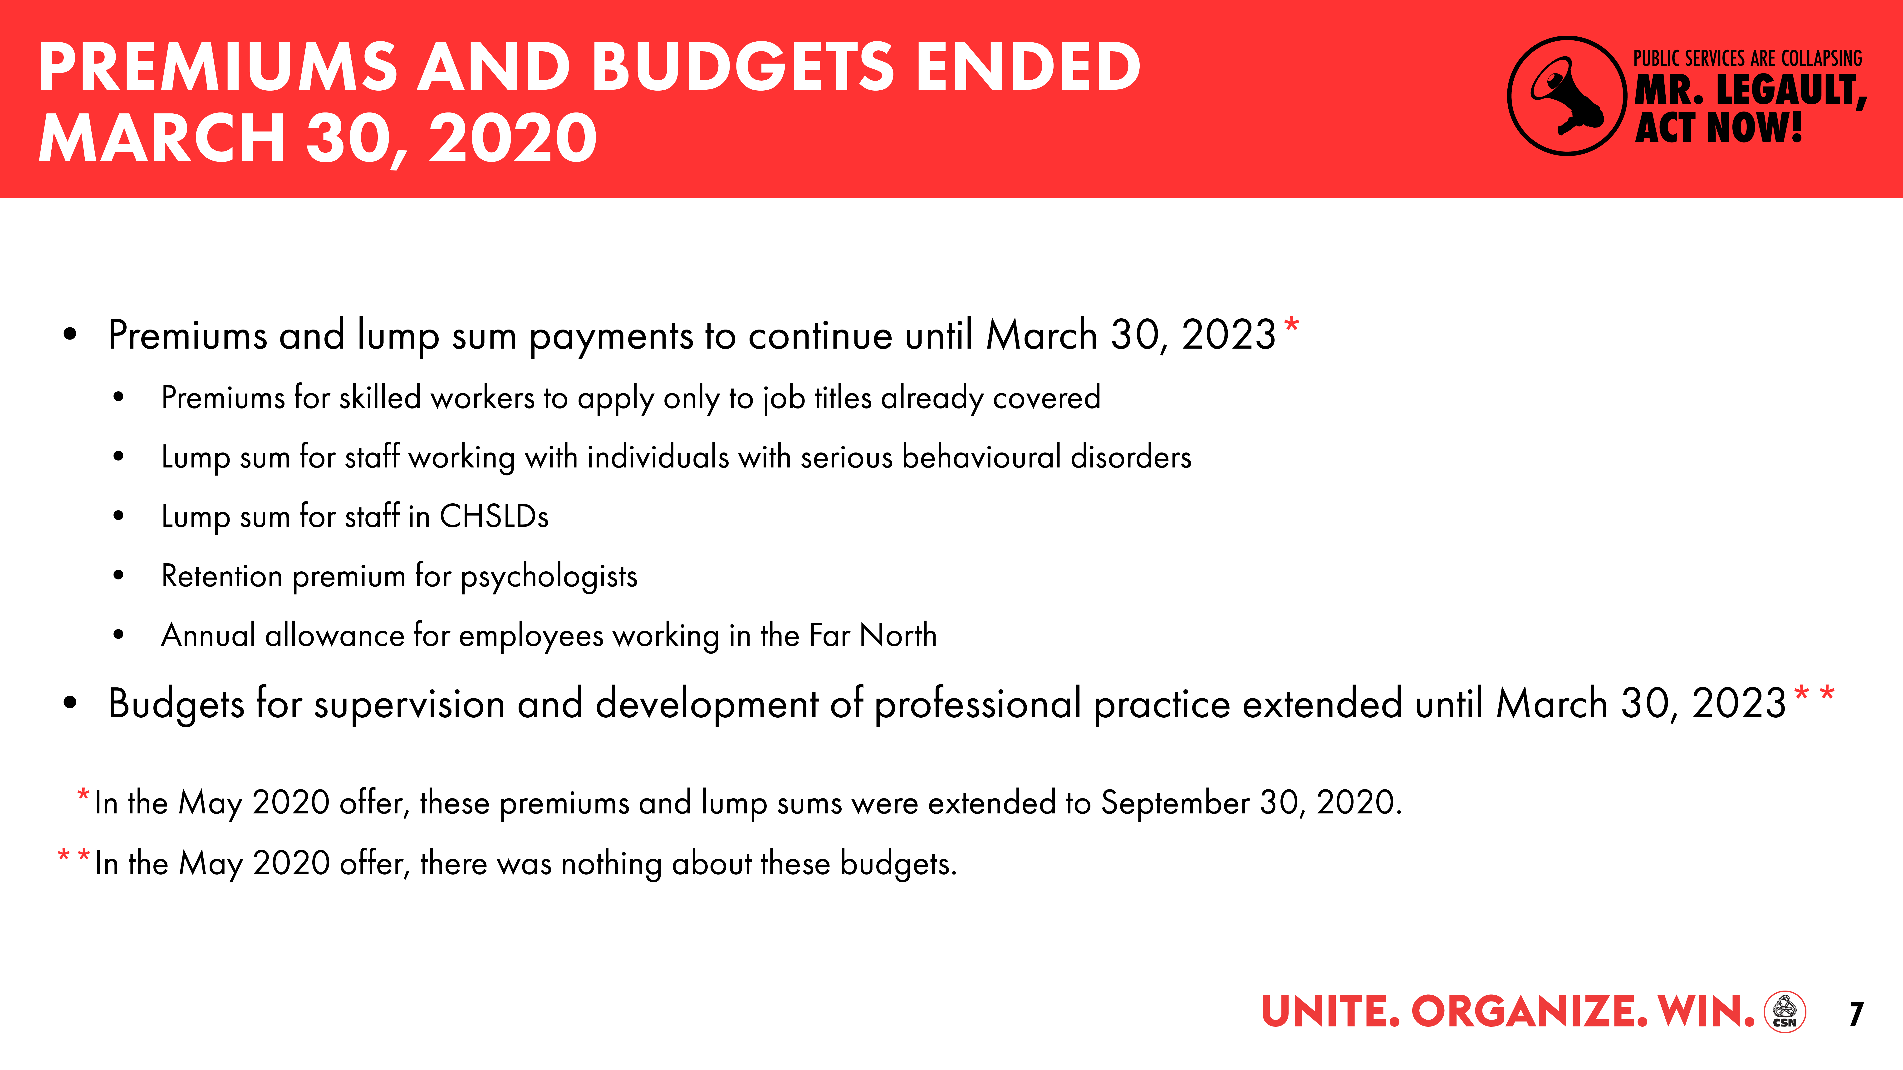

Slide 8
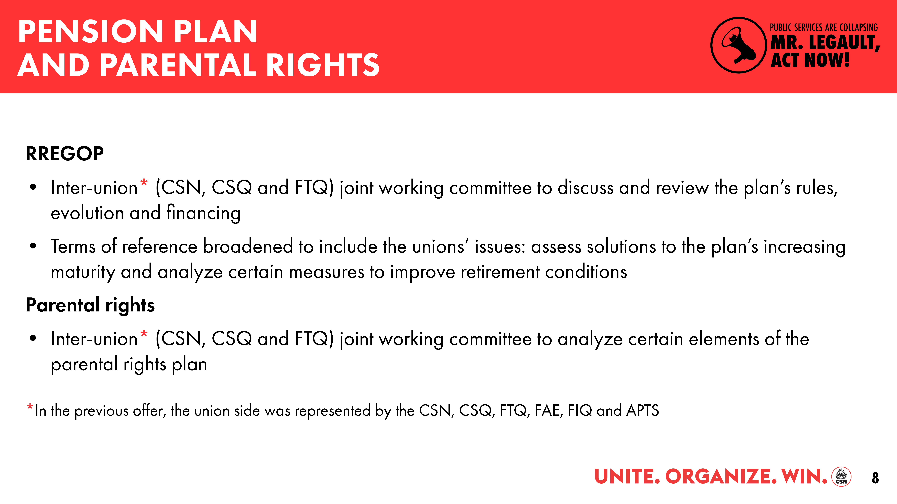

Slide 9
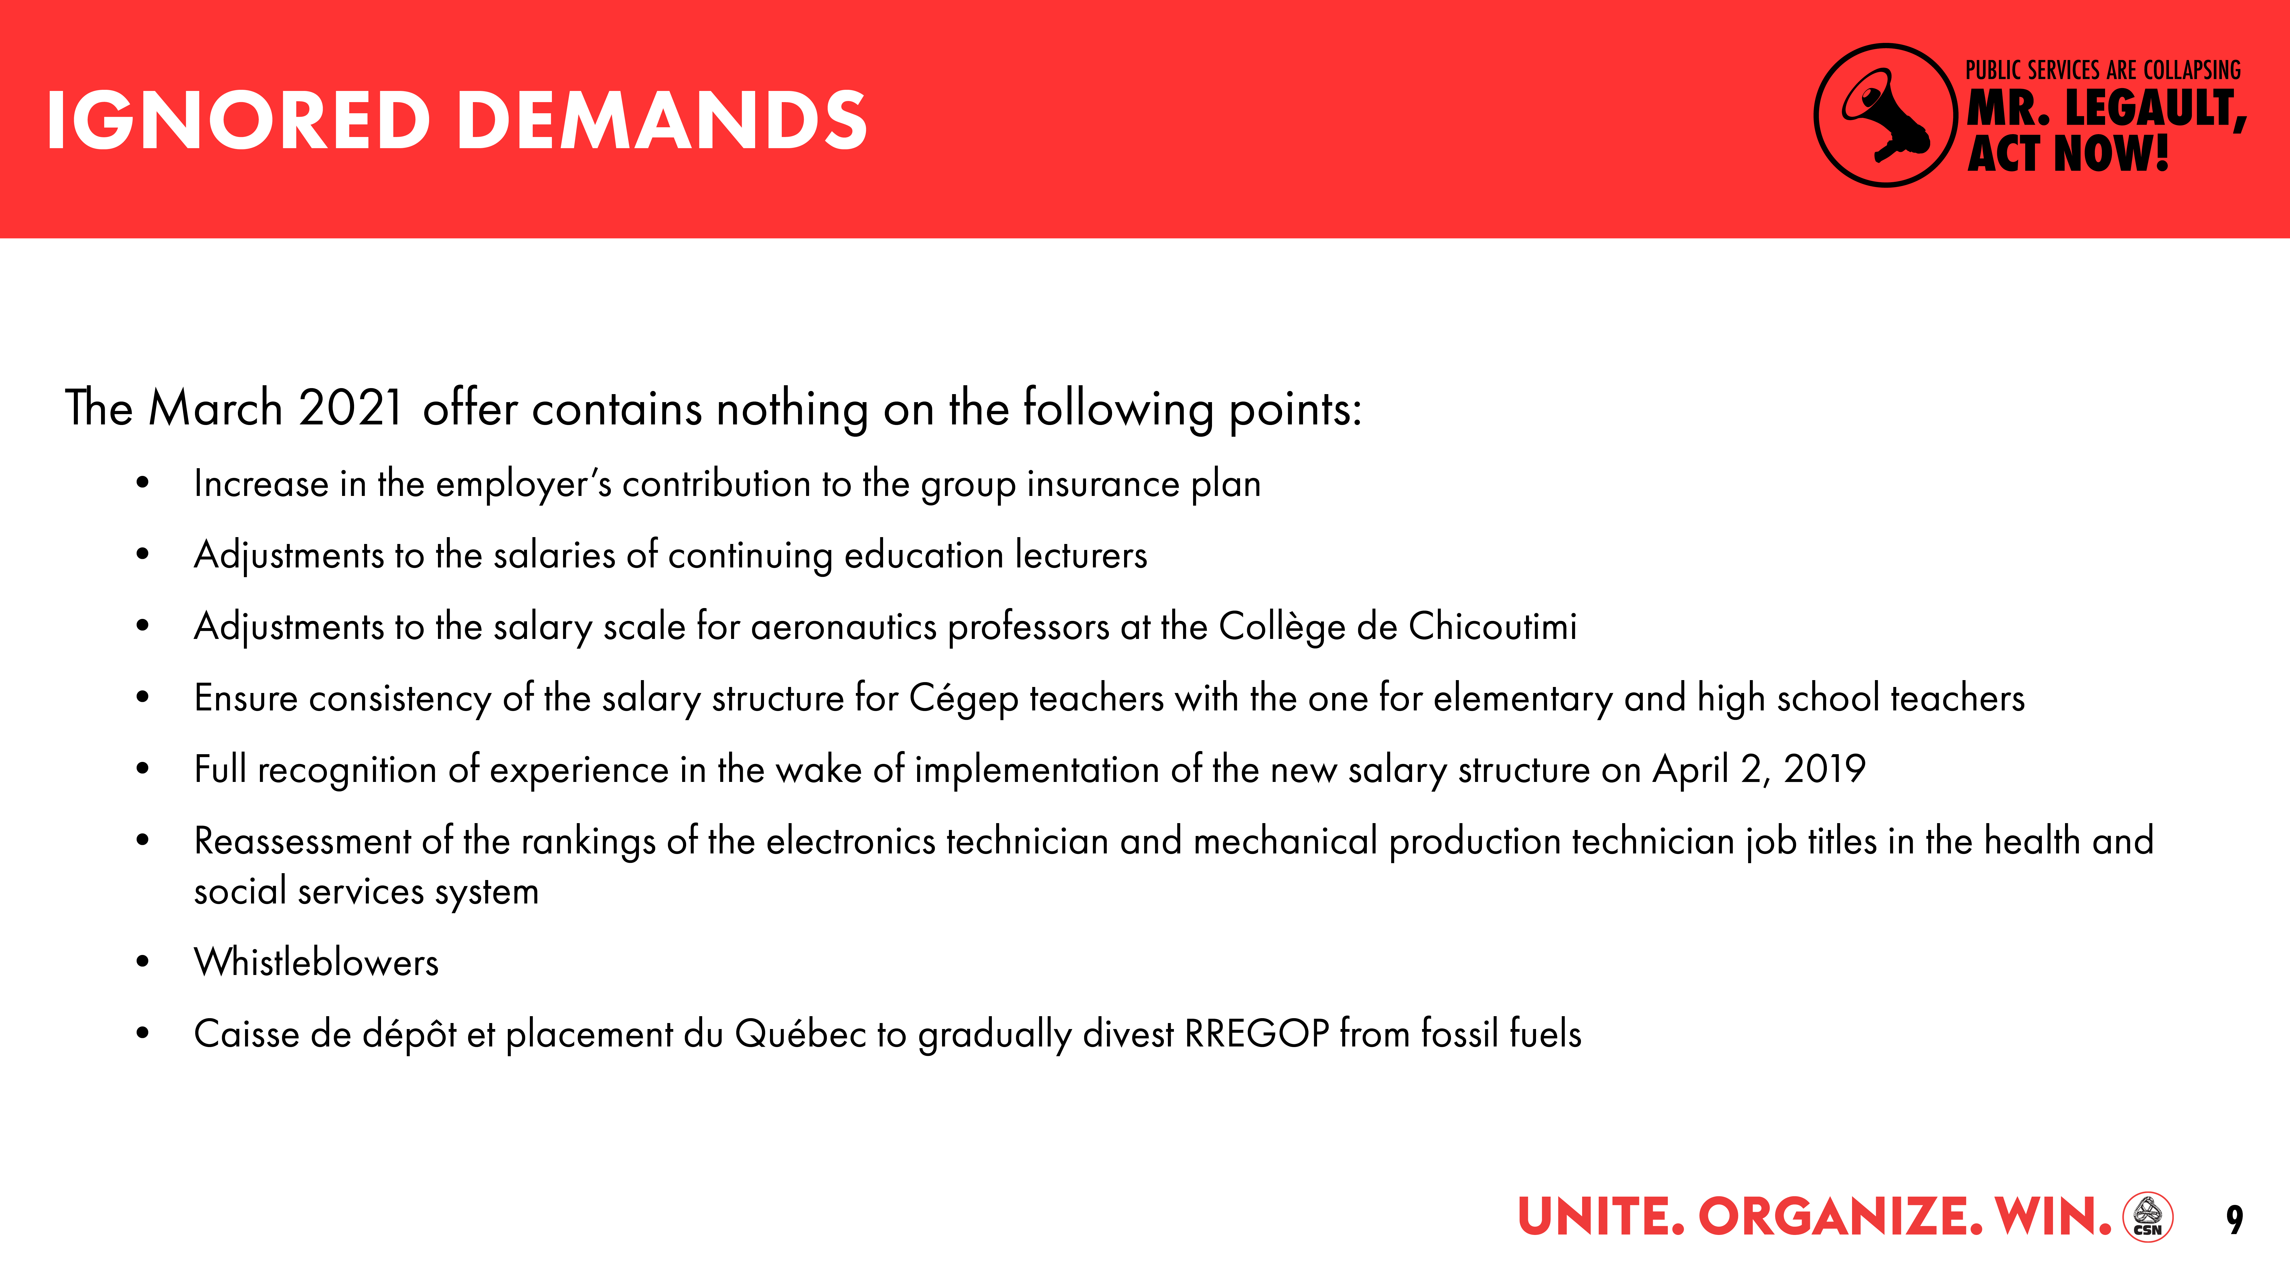

Slide 10
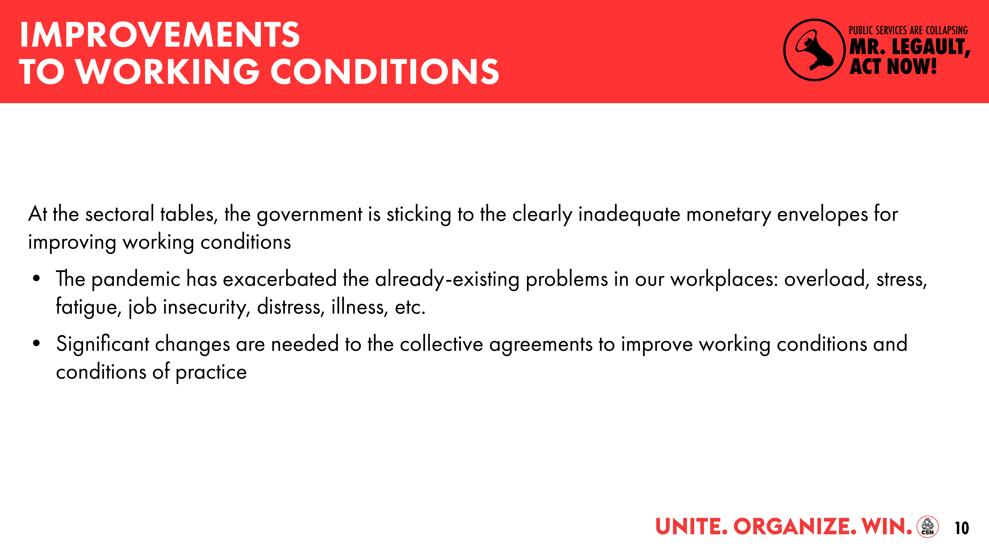

Slide 11
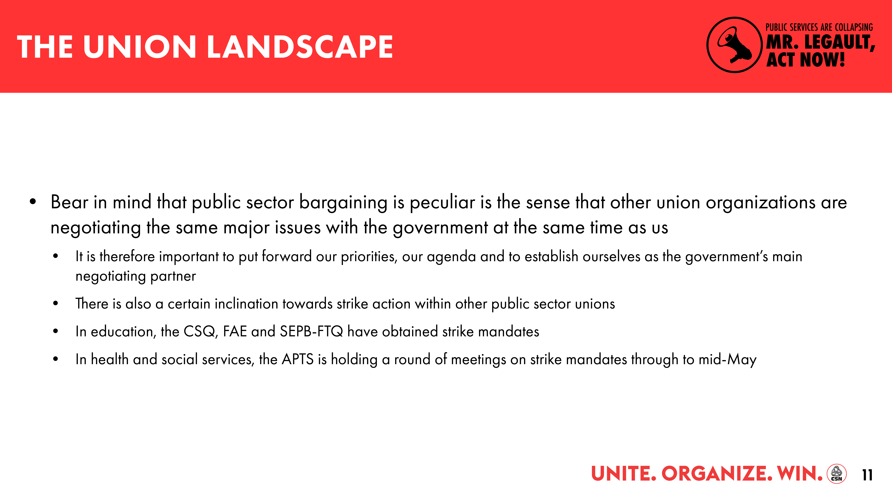

Slide 12
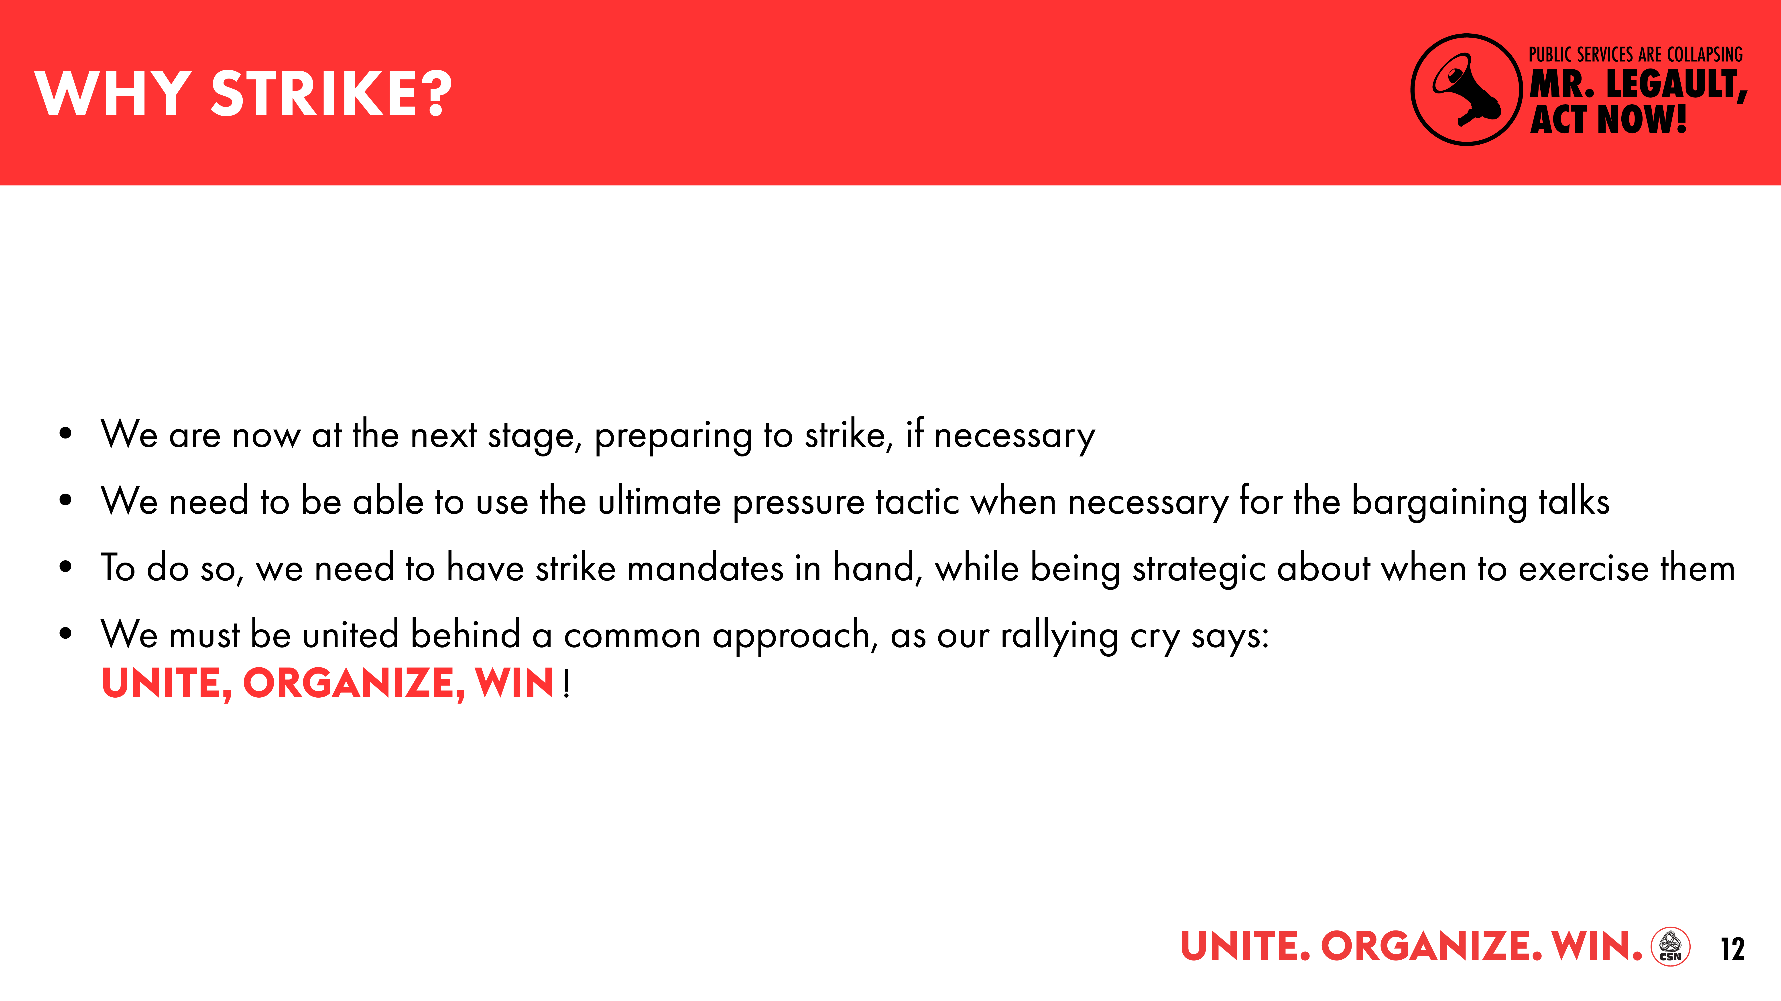

Slide 13
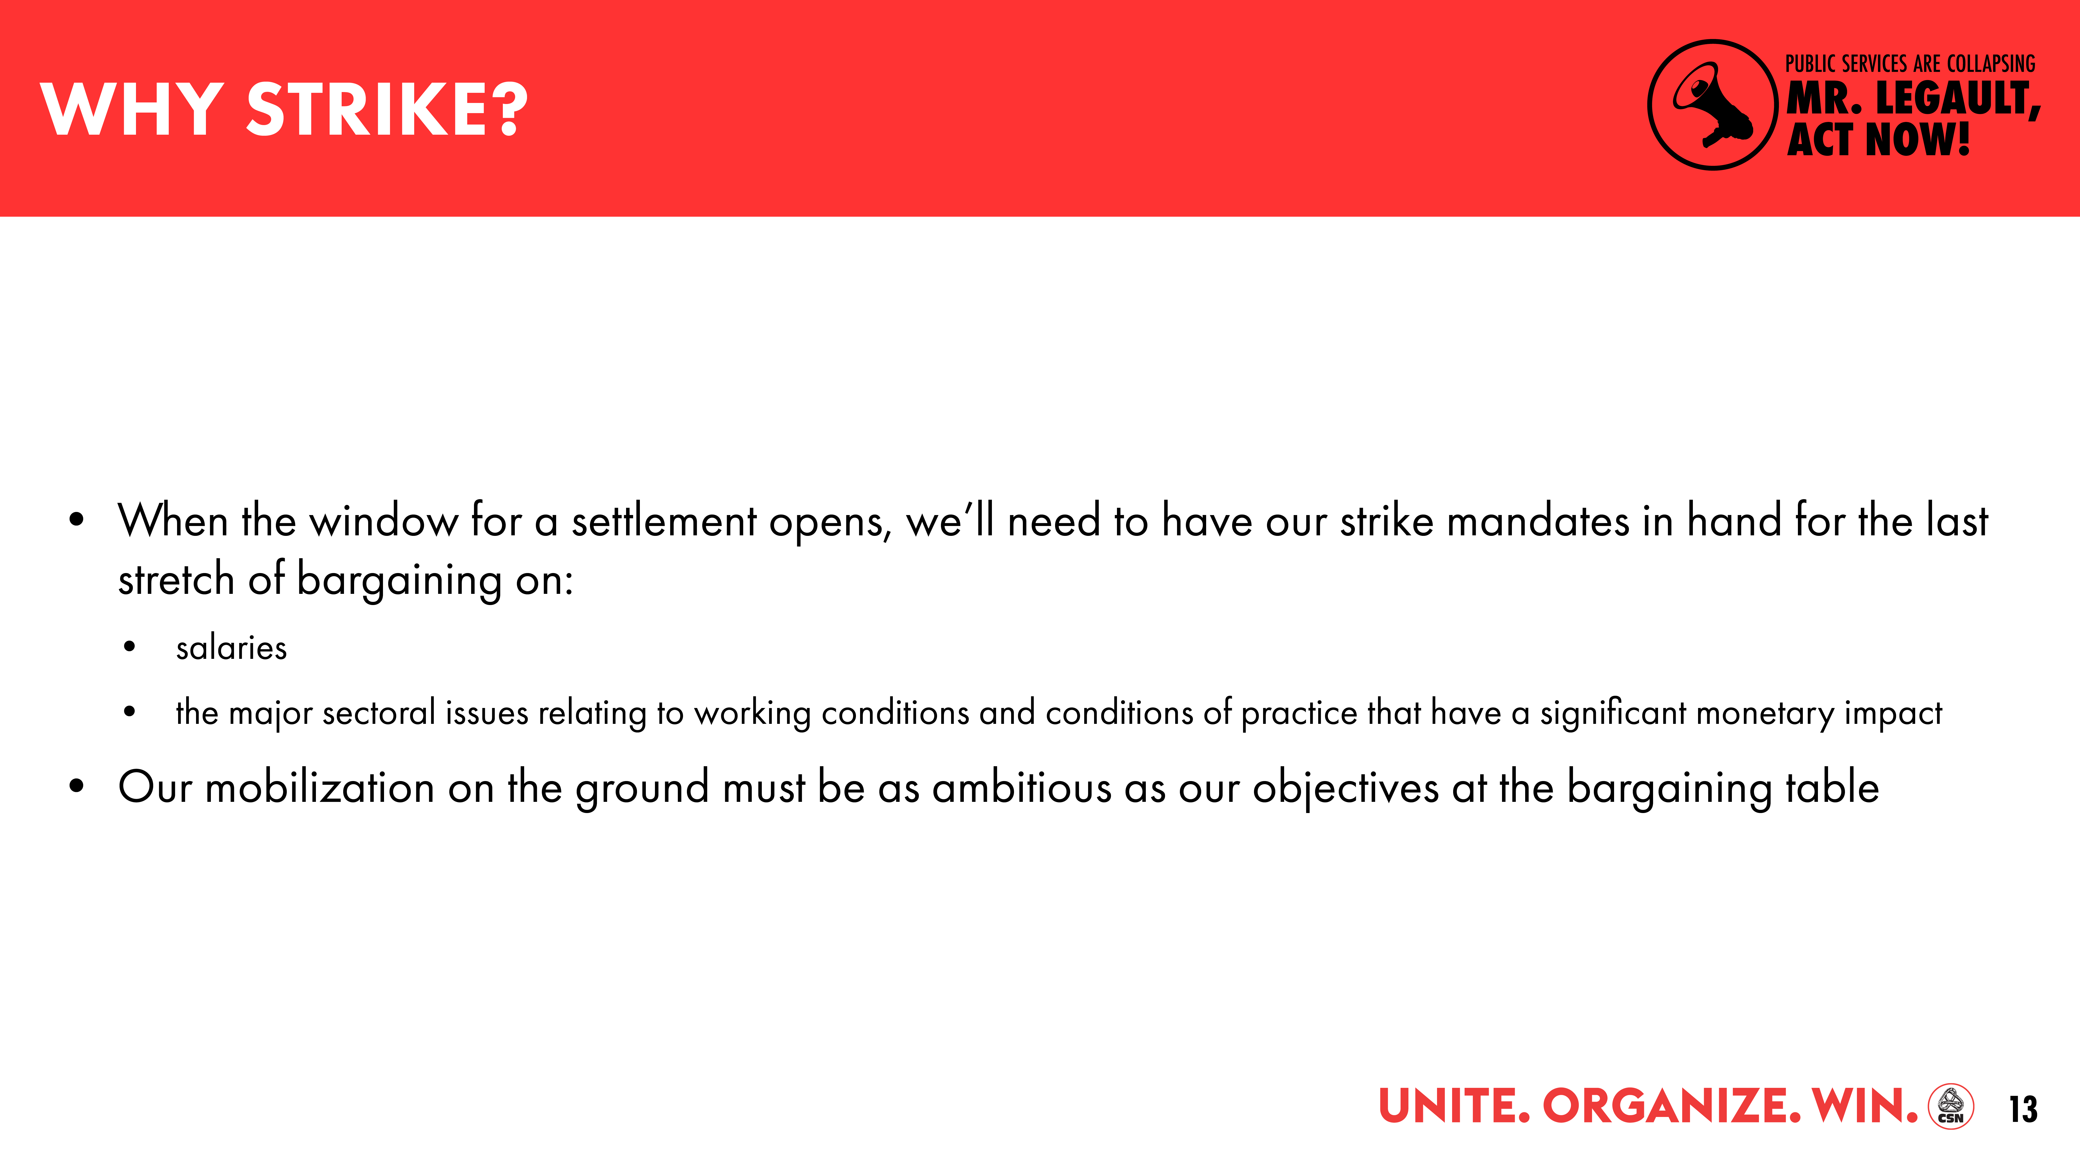

Slide 14
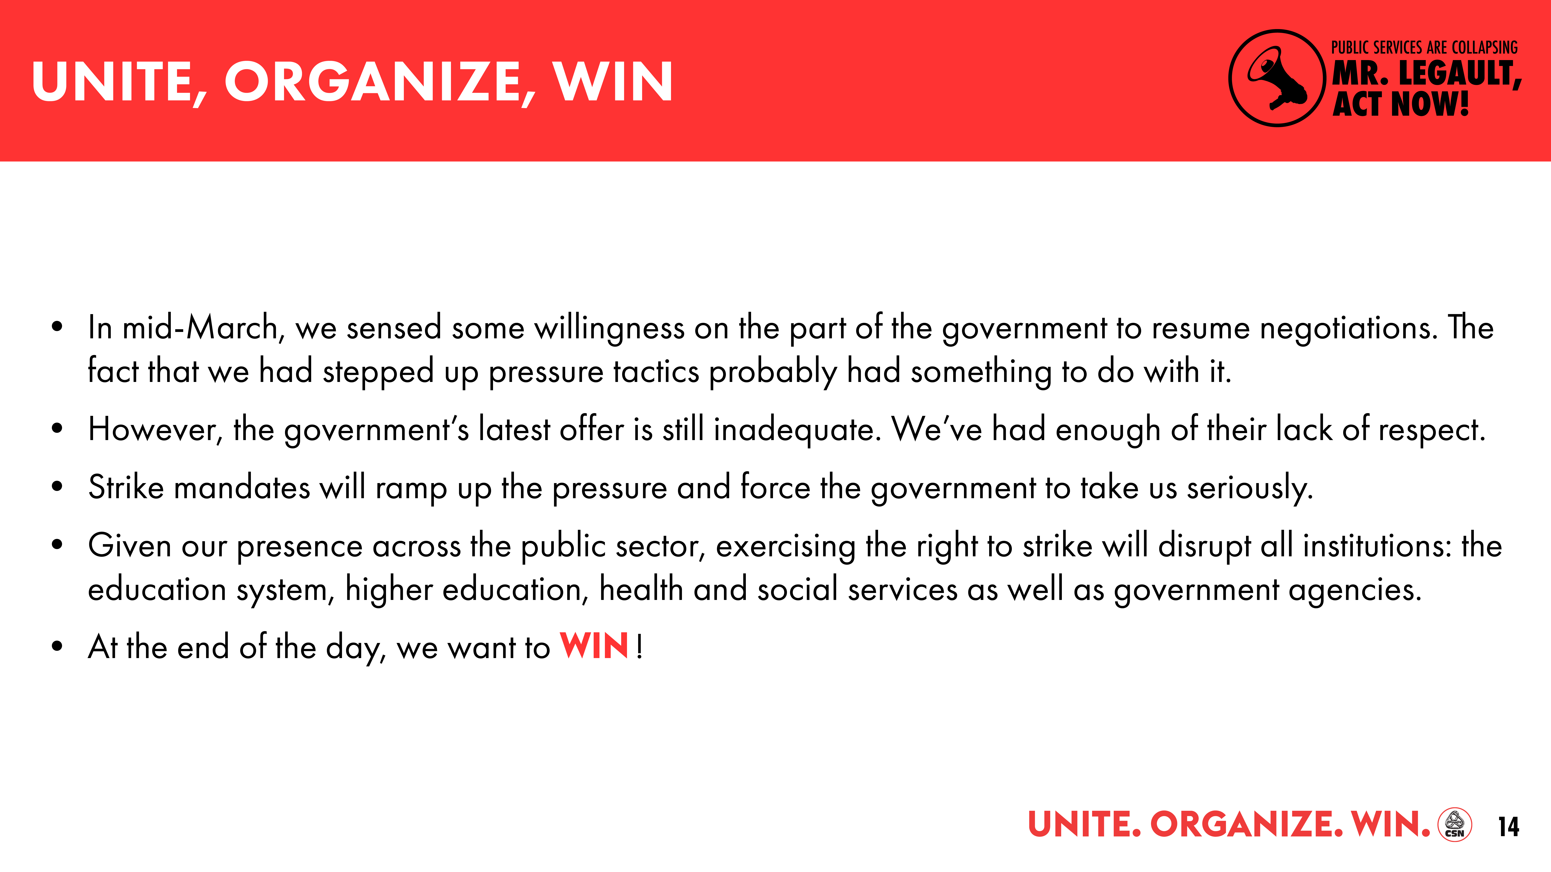

Slide 15

SECTORAL TABLE BARGAINING REPORT
SPRING 2021

Slide 16
STATUS OF SECTORAL TALKS
October 29, 2019: Union tables demands
As of April 7, 2021: 59 bargaining sessions held
March 31, 2021: Government tables new, grossly inadequate offer
Further deterioration of working conditions, very little progress on our demands
No increase in the budget envelope allocated to the sectoral tables to improve working conditions

Slide 17
GOVERNMENT OFFER OF MARCH 31, 2021
EXAMPLES OF PROPOSED DOWNGRADES IN WORKING CONDITIONS
Abolish premiums for group leaders and assistant group leaders
Reduce training budgets provided for in Article 13 of the collective agreement
Eliminate provisions in collective agreement that hours worked on weekly days off are considered overtime
Increase the number of hours in the work week for a some job titles in order to force longer presence at work and pay less overtime

Slide 18
GOVERNMENT OFFER OF MARCH 31, 2021
SOME SLIGHT BUT INSUFFICIENT PROGRESS
Enhance bereavement leave
Recognize all accumulated years of service in the health and social services system for all employees for the purpose of calculating annual vacation leave
Reimburse of parking expenses at home base for employees who are required to use their personal vehicle on the job
Possibility for part-time employees to take early leave for family-work-studies balance with pay averaging

Slide 19
GOVERNMENT OFFER OF MARCH 31, 2021
NOTHING ABOUT:
Immediate implementation of preventive health and safety measures
Evaluation of the salary rankings of some job titles
Staff attraction and retention
Reduction of excessive workloads
Work organization
Requirements and conditions for access to positions for a number of job titles

Slide 20
GOVERNMENT OFFER OF MARCH 31, 2021
CLASS 1
The government wants to impose on us the agreement in principle it reached with the FIQ in December
That agreement, which has yet to be voted on by the FIQ's membership, is clearly inadequate and in fact downgrades some working conditions

Slide 21
GOVERNMENT OFFER OF MARCH 31, 2021
CLASS 1 (continued)
Sign a letter of agreement with the following provisions:
    Add 1,000 full-time equivalents in CHSLDs across the health and social services system
    Process for increasing full-time positions
      80% target for CHSLDs, emergency and obstetrical care
      70% target for 24/7 services
    Premium for employees with a full-time evening, night or rotating position in a 24/7 service (premium ends on March 30, 2023)
      Evening: 3% + 1% upon achievement of 70% full-time target
      Night: 2% + 0.5% upon achievement of 70% full-time target
Reduce the use of independent labour without writing it into the collective agreement

Slide 22
GOVERNMENT OFFER OF MARCH 31, 2021
CLASS 1 (continued)
Some points in the government offer:
Increase the attendance premium for working the weekend shift for employees with a full-time position in a 24/7 service from 4% to 8%
Make specialty nurse practitioners’ salaries retroactive to date of OIIQ exam
Base premiums for working in a CHSLD on the premiums for beneficiary attendants
Increase incumbency to 14 shifts per 28 days
Allow automatic reclassification of employees with a bachelor's degree in nursing to the nurse clinician job title
Pilot projects (knowledge transfer and self-scheduling)

Slide 23
GOVERNMENT OFFER OF MARCH 31, 2021
CLASS 1 (continued)
Some points in the government offer:
No solution to the basic problems with working conditions for nursing and cardio-respiratory care personnel
  Improvements to some working conditions only for personnel holding a full-time position
  No help with work-life-study balance
  Nothing about patient ratios
  Nothing to reduce excessive workloads
The government offers for full-time employees create discrimination/disparity between employees holding a full-time position and those who work part-time or do not hold a position

Slide 24
GOVERNMENT OFFER OF MARCH 31, 2021
CLASS 2
The only priority groups for the government are beneficiary attendants and health and social services aides
Nothing for other Class 2 job titles
Some points in the government offer:
Increase the work week instead of paying the 2% non-overlap premium for:
  Rehabilitation assistants (36.25 hrs.)
  Medico-legal intervention officers (36.25 hrs.)
  Psychiatric intervention officers (37.5 hrs.)

Slide 25
GOVERNMENT OFFER OF MARCH 31, 2021
CLASS 2 (continued)
Beneficiary attendants (PABs) and health and social services aides (ASSSs)
Move up 2 salary rankings as of the date of signing of the agreement in principle
Single rate for rank 9: currently $23.87 per hour (to be increased based on the outcome of the negotiations on pay parameters)
The $26 per hour applies only to PABs working in CHSLDs
The promise doesn't apply to any other PABs (e.g. those working in hospitals) or ASSSs
PABs working in CHSLDs will get to $26 per hour only by accumulating premiums,
which aren't taken into account in pension calculations
Conditional on settling the 2010 and 2015 pay equity complaints for all other Class 2 job titles

Slide 26
GOVERNMENT OFFER OF MARCH 31, 2021
CLASS 2 (continued)
Despite the Pay Equity Act, the government still links this issue to the negotiation of the collective agreement with the proposed rank 9 to the date of signing of the agreement in principle. This increase in rank is already due. By doing so, the government deprives the PABs and ASSSs of retroactive pay. It’s unacceptable!
The government cannot try to recover the amounts owed on the backs of working women!But as even Minister Lebel acknowledges, pay equity isn't negotiable!

Slide 27
GOVERNMENT OFFER OF MARCH 31, 2021
CLASS 3
Create a Paralegal job title
Possibility of recognition of an Attestation of College Studies or a university certificate, combined with experience, for some technician job titles
Apart from these two concessions, no willingness whatsoever on the part of the government to do anything about working conditions for members of Class 3
Instead, the government wants to:
  Increase the work week for IT job titles to 40 hours
  Discuss telework after the collective agreement has been signed

Slide 28
GOVERNMENT OFFER OF MARCH 31, 2021
CATEGORY 4
The government's priority: youth centres
The government's offer for Class 4 personnel falls far short of what is needed to resolve the daily problems in all sectors at the institutions where we work

Slide 29
GOVERNMENT OFFER OF MARCH 31, 2021
CLASS 4 (continued)
Sign a letter of agreement for Class 4 personnel working in youth centres
  Add 500 full-time equivalents across the system
  Mandatory incumbency of minimum 12 shifts per 28 days
  1.5% premium*
  2% non-recurring premium during the period preceding the addition of more staff
  (maximum March 30, 2023)
  Eliminate Appendix R regarding special conditions for closed custody, intensive supervision and evaluation of reports
  Pilot projects (joint psychosocial intervention, key case worker, community of practice)
  * Employees receiving lump sum or compensatory leave pursuant to letter of agreement 33 (serious behavioural disorders) will not be eligible for these premiums

Slide 30
GOVERNMENT OFFER OF MARCH 31, 2021
CLASS 4 (continued)
Some points in the government offer:
2% ad hoc daily premium for employees assigned to supervising internships in a job title that requires membership in a professional order (cannot be combined with the professional coordination premium and cannot be paid to employees whose job description includes training or teaching)
Amend Appendix G (appendix for professionals) to make "academic training" refer to academic training pertinent to the profession beyond a final university degree required for the job title
  In exchange for this downgrade of working conditions, the government is offering to lift the salary ceiling by 1.5% for a master's degree and 3% for a Ph.D.

Slide 31
GOVERNMENT OFFER OF MARCH 31, 2021
CLASS 4 (continued)
Some points in the government offer:
Remove the requirement to work at least 3 hours to be entitled to the critical care premium, including the enhanced premium, and the specific critical care premium, including the enhanced premium, for the job titles that already qualify
Increase the work week to 37.5 hours for job titles working with mental health clients:
  Social workers
  Educators
  Human relations officers
  Specialized education technicians
  Psychoeducators

Slide 32
GOVERNMENT OFFER OF MARCH 31, 2021
CLASS 4 (continued)
Some points in the government offer:
Increase the work week to 40 hours for the psychologist job title
Letter of agreement on the creation of a national joint committee on the workloads of Class 4 personnel to document conditions of practice and assess workloads
Mandatory incumbency of minimum 12 shifts per 28 days for some job titles working with mental health clients
  Social workers
  Educators
  Human relations officers
  Specialized education technicians
  Psychoeducators
  Psychologists

Slide 33
GOVERNMENT OFFER OF MARCH 31, 2021
  For all classes of personnel, the government offer of March 31, 2021 falls far short of what is needed to attract and retain staff
  It shows the government is totally out of touch with the daily problems experienced by workers in the health and social services system

Slide 34
GOVERNMENT OFFER OF MARCH 31, 2021
  To add insult to injury, when the government tabled its new budget on March 25, 2021, it announced that COVID premiums would end in August 2021 and it did not allocate the amounts needed to maintain health and social services for Quebecers at current levels

Slide 35
GOVERNMENT OFFER OF MARCH 31, 2021
  The government's contempt must stop!

